Slide 1
Total Benzene DB
Comprehensive Solution for Efficient Gas Station Operations

Slide 2
Table of contents
01
02
03
Introduction
System Overview
Problem, solution and Goal
04
05
System Design
Requirement Analysis
Functionalities & Components
06
GUI
ER diagram , DB schema

Slide 3
Table of contents
07
08
09
Implementation
Experience Gained
10
Future Enhancements
Conclusion
Ai model
integration
Development & challenges
11

Slide 4
Introduction
In the fast-paced environment of gas stations, efficient data management is crucial for smooth operations and customer satisfaction.
Traditional manual processes and inconsistent data handling can lead to significant operational challenges.

Slide 5
Problems
Inconsistent Data Handling
Time-Consuming Manual Processes
Inaccurate Inventory Tracking
Lack of Real-Time Data Access

Slide 6
The Goal
Improve Data Accuracy and Accessibility
Enhance Operational Efficiency
Support Better Decision-Making

Slide 7
Our Solution
The proposed solution is a robust database management system that integrates various functionalities required by a gas station.

Slide 8
Solution Advantages
• Data Accuracy
• Operational Efficiency
• Inventory Management
• Decision-Making
• Statistics and data analysis

Slide 9


System Overview
System components
GUI using python pyqt5 library
DB using MySQL

Slide 10
System Overview
System Functionalities Examples
User Management: Add, delete, update
Fuel Management: Track fuel types, prices
Expenses Management: Record and track expenses with purpose and amount
Inventory Management: Monitor fuel levels, store items
And Much More !!

Slide 11
Requirement analysis
System users
Administrators: Manage overall system operations.
Employees: Enter transactions and manage daily operations.
Accountants: Access reports and analytics for decision-making.

Slide 12
Requirement analysis
Main Requirements
• Deferred Customers
• Cash Register
• Employees
• Fuel types/ pumps
• Coupons
• Logs
• System Users
• Prices
• Daily Shift
• Oils
• Expenses

Slide 13
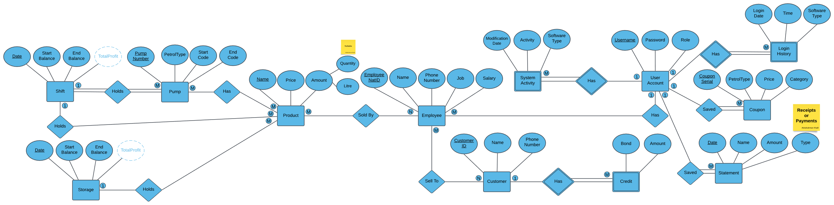
System design
ER Diagram

Slide 14
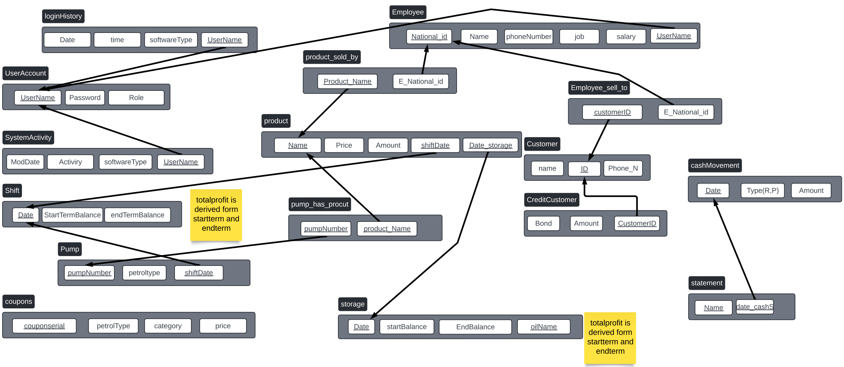
System design
Database Schema

Slide 15
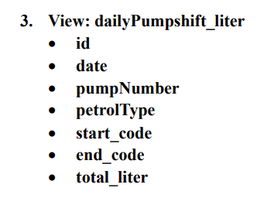
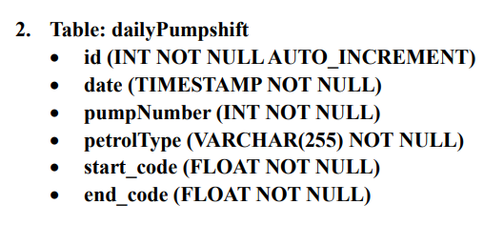
System design
Database Schema (Tabels)
Table
View

Slide 16
GUI
Functionality
Intuitive Interface: Easy navigation, quick proficiency.
Automation: Streamlines tasks, minimizes errors.
Real-time Updates: Access latest information instantly.
Data Accuracy: Maintains high precision, reliable information.
Visual Appeal: Organized layout, enhanced user experience.

Slide 17
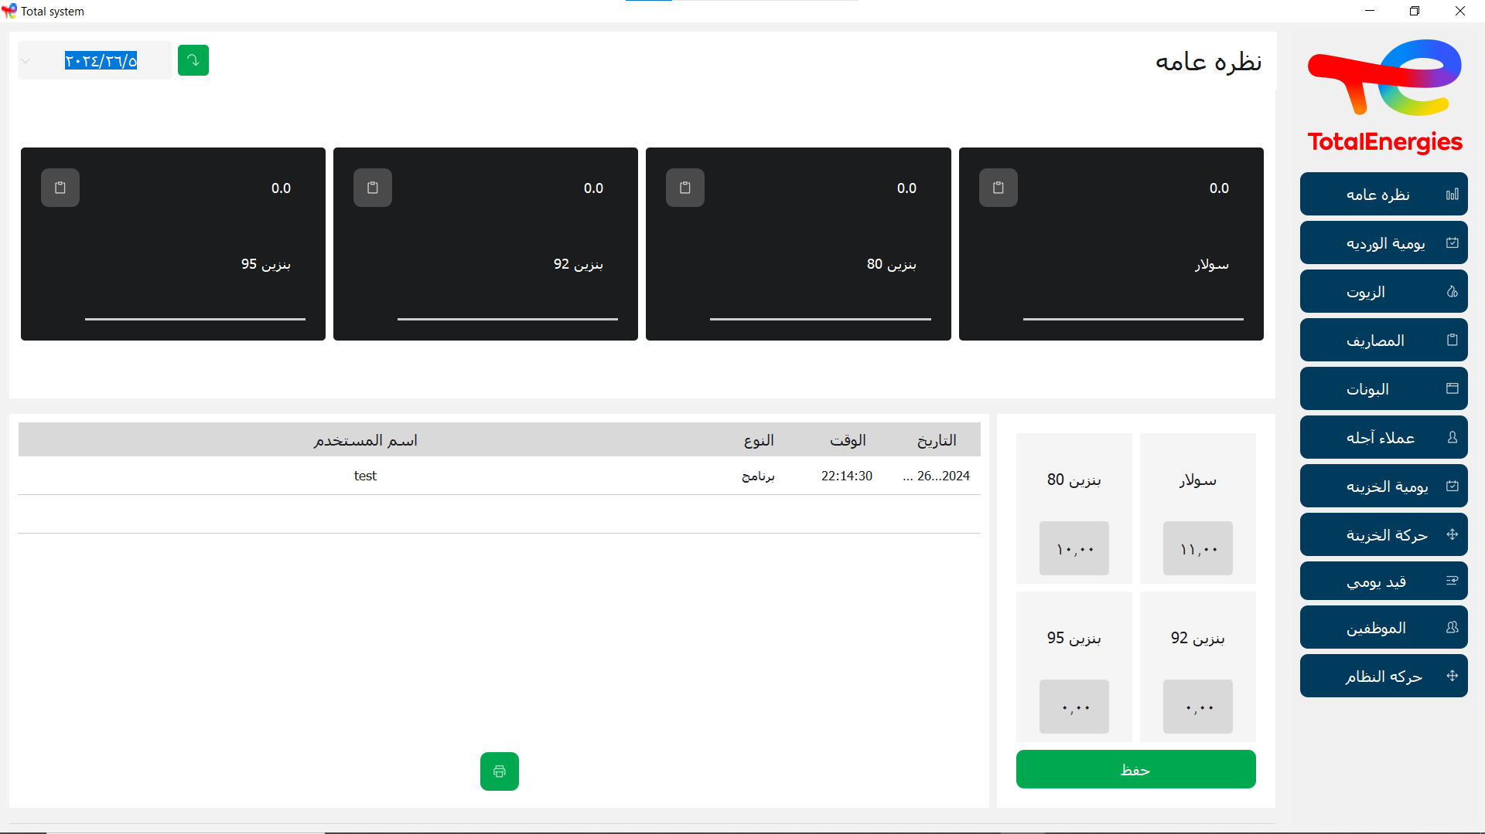
GUI
Snapshots

Slide 18
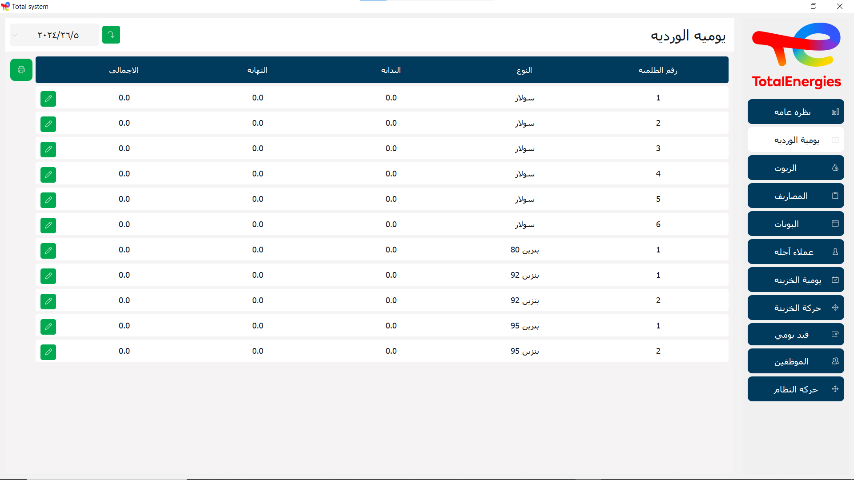
GUI
Snapshots

Slide 19
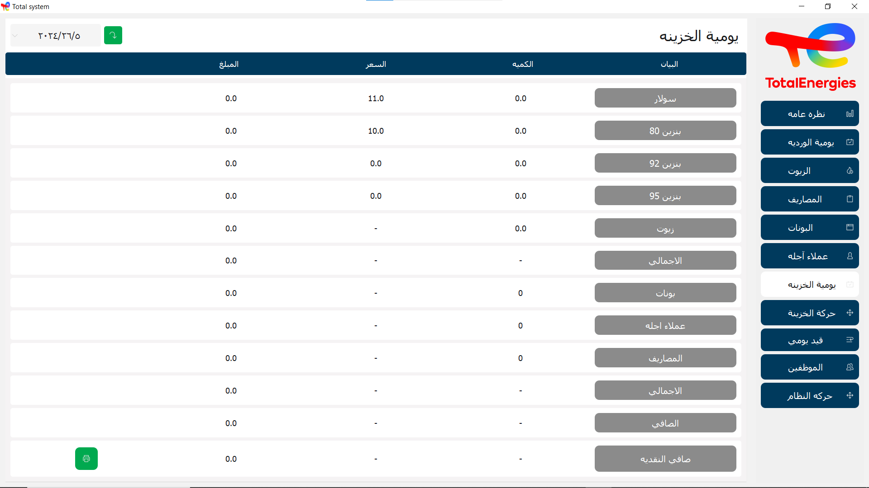
GUI
Snapshots

Slide 20
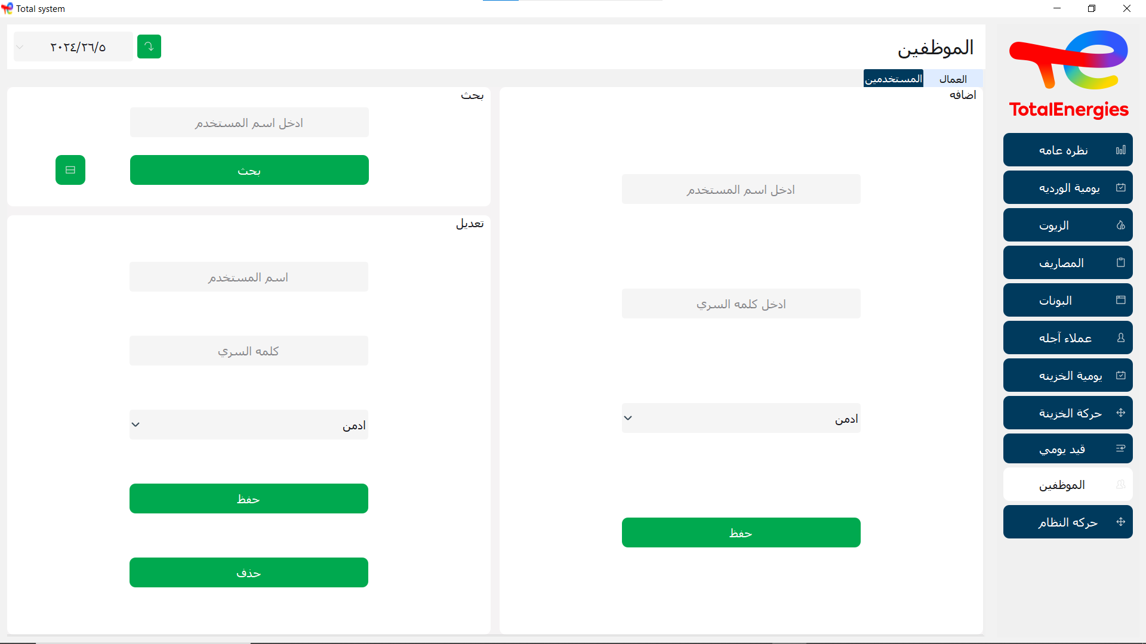
GUI
Snapshots

Slide 21

Ai integration
Using Gemini
Objective:
enhance the functionality of the system by integrating artificial intelligence capabilities while maintaining data privacy.

Slide 22
Ai integration
Using Gemini
Process
1. Query Creation: take input from the user
2. Query Extraction: model extracts the query from the user input
3. Query Execution: automatically execute the extracted query
4. Output Handling: formats the results into tables
5. Output Presentation: Tables are displayed using GUI

Slide 23
Implementation
Planning
Development
1
2
Testing
Deployment and Maintenance
4
3

Slide 24
Challenges
Designing the Entity-Relationship Diagram (ERD) for a gas station, given its complexity and the presence of several non-intuitive concepts.

Slide 25
Solution
Thorough research was utilized to understand the various concepts in the gas station's operations. By breaking down the problem into smaller parts and continuously refining the design, a robust ERD was eventually developed.

Slide 26
Experience Obtained
Technical Skills
Project Management
Troubleshooting
experience

Slide 27
Future Enhancements
Mobile Compatibility
Advanced Analytics
Scalability
Develop mobile app
With friendly UI
For user accessibility
On the go
Optimize the system to support larger gas station chains and include other services like restaurants & more
Use Ai to enhance analytics

Slide 28
Conclusion
The Total Benzene DB system significantly enhances data accuracy, operational efficiency, and decision-making capabilities for gas stations.
By automating key processes and providing real-time data access, the system addresses many of the operational challenges faced by gas stations.
GAS

Slide 29
Our team
Nour Maher
221101140
221100039
Abdelrahman Tharwat
Yassin waleed
221100979
Ahmed Mohamed
221100128
Karim mamdouh
222102535
223108628
Shrouq Hisham
Youssef gamal
221101013
Youssef wael
221101027

Slide 30
Thanks!

